Slide 1

Pattern Recognition
Chapter 2: Pattern Representation
Chumphol Bunkhumpornpat
Department of Computer Science
Faculty of Science
Chiang Mai University

Slide 2
Learning Objectives
KDD Process
Know that patterns can be represented as
  Vectors
  Strings
  Logical descriptions
  Fuzzy sets

Slide 3
Learning Objectives (cont.)
Have found out what is involved in abstract of data
Know the parameters involved in evaluation of classifiers

Slide 4
Learning Objectives (cont.)
Have found out what is involved in abstract of data
Know the parameters involved in evaluation of classifiers

Slide 5
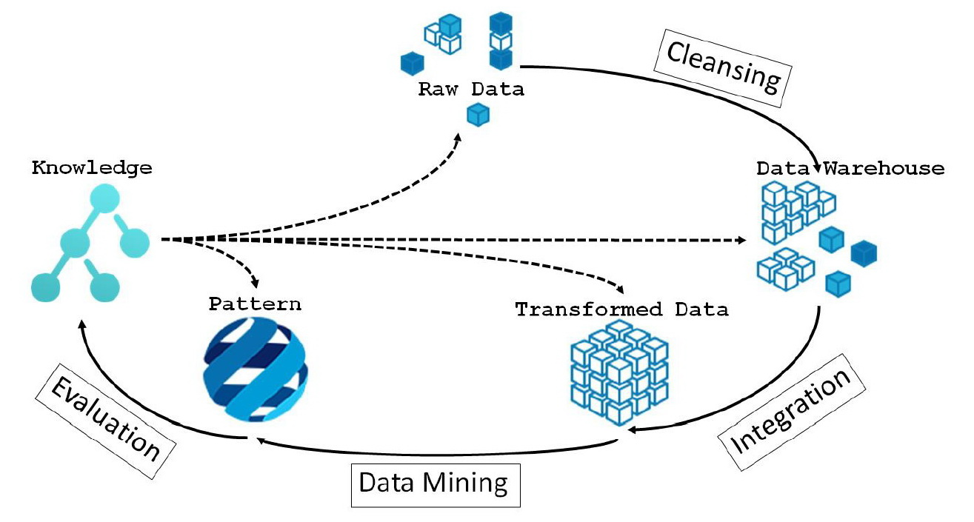
KDD (Knowledge Discovery in Databases) Process

Slide 6
Representation
Pattern
  Physical Object
  Abstract Notion
Pattern: A Set of Descriptions
  Animal: ?
  Ball: Size, Material

Slide 7
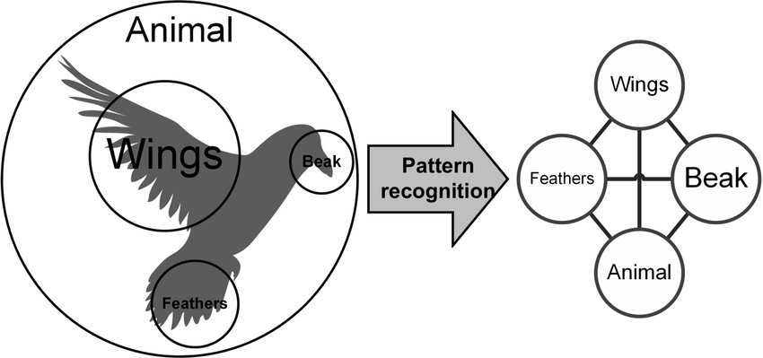
Pattern is the representation of an object by the values taken by the attributes (features)

Slide 8
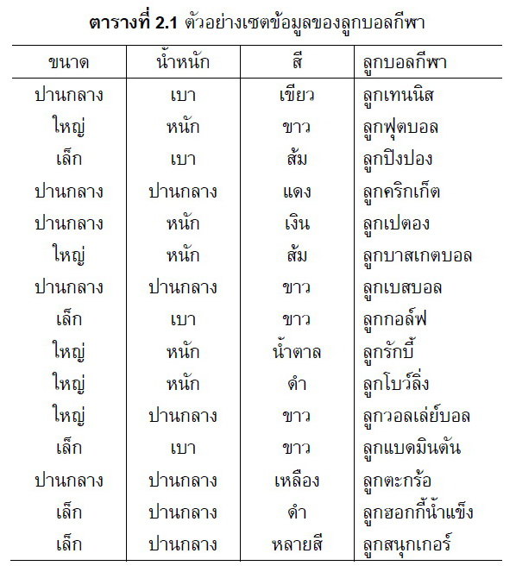

Slide 9
Classification
A dataset has a set of classes, and each object belongs to one of these classes.
  Animals (Pattern): Mammals, Reptiles (Classes)
  Balls (Pattern): Football, Table Tennis Ball (Classes)
Common technique that separates patterns into different classes.

Slide 10
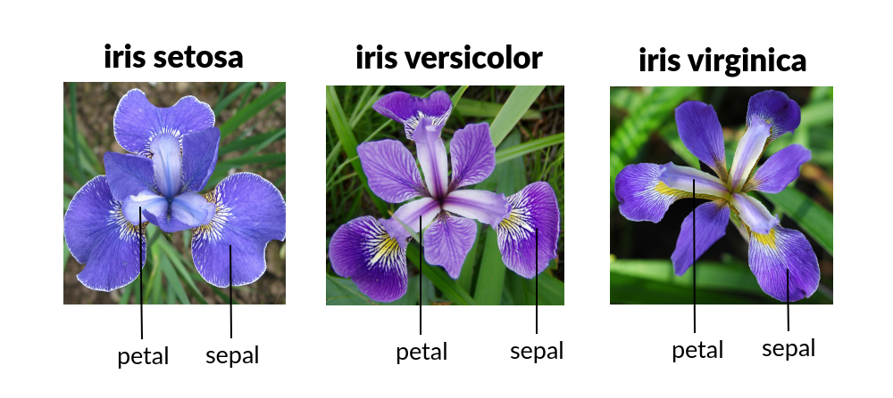
Iris Dataset

Slide 11
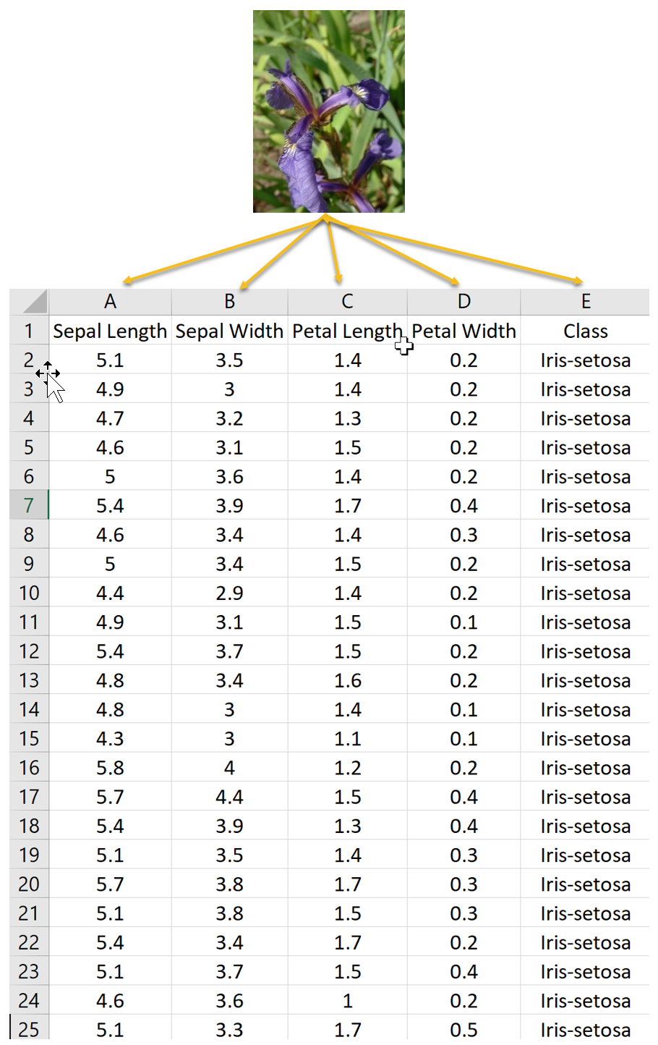

Slide 12
Patterns as Vectors
An Obvious Representation of a Pattern
Each element of the vector can represent one attribute of the pattern.

Slide 13
Spherical Objects
(30, 1): 30 units of weight and 1 unit diameter
(30, 1, 1): The last element represents the class of the objet (spherical objects).

Slide 14
Example 1
1.0, 1.0, 1 ; 1.0, 2.0, 1
2.0, 1.0, 1 ; 2.0, 2.0, 1
4.0, 1.0, 2 ; 5.0, 1.0, 2
4.0, 2.0, 2 ; 5.0, 2.0, 2
1.0, 4.0, 2 ; 1.0, 5.0, 2
2.0, 4.0, 2 ; 2.0, 5.0, 2
4.0, 4.0, 1 ; 5.0, 5.0, 1
4.0, 5.0, 1 ; 5.0, 4.0, 1

Slide 15
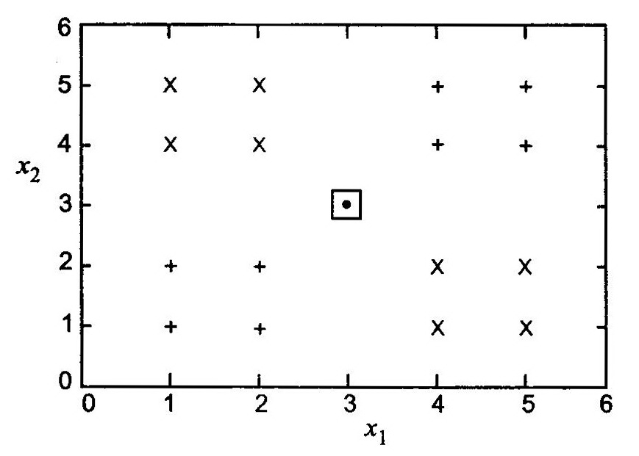
Example Data Set:
The Square Represents a Test Pattern

Slide 16
Patterns as Strings
A gene can be defined as a region of the chromosomal DNA constructed with four nitrogenous bases:
  Adenine: A
  Guanine : G
  Cytosine: C
  Thymine: T
GAAGTCCAG

Slide 17
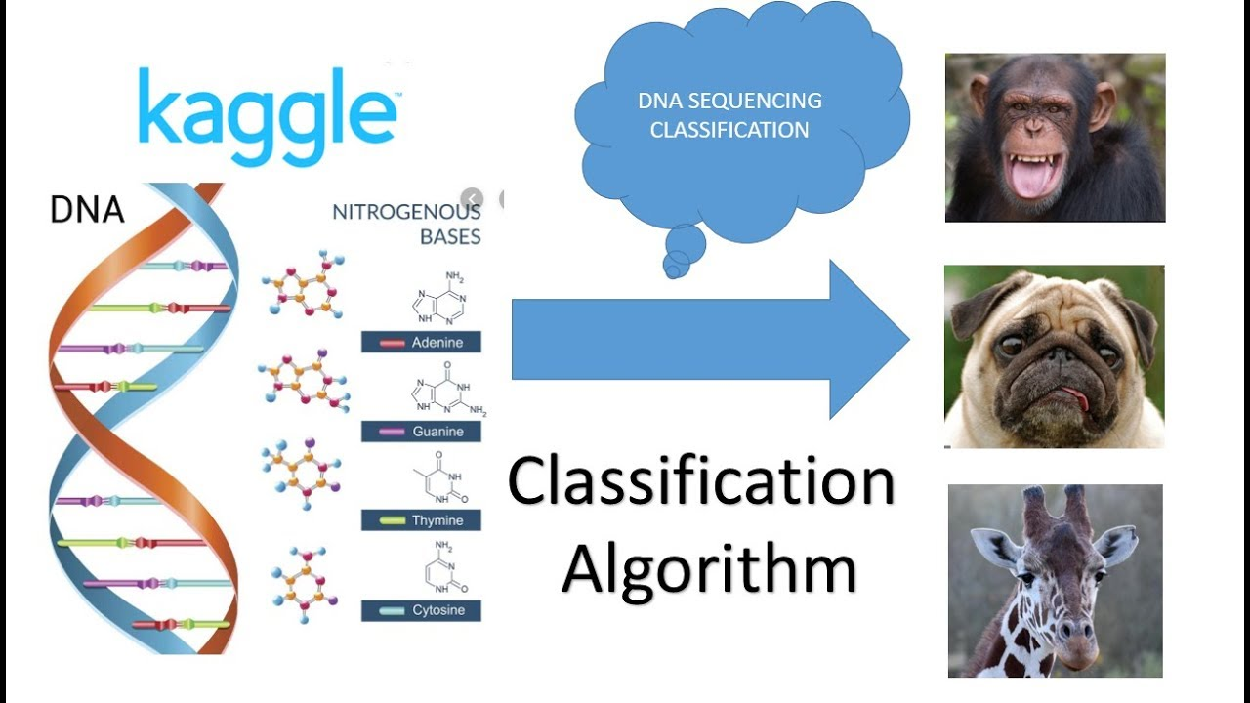
17

Slide 18
Logical Descriptions
x₁ and x₂ : The attributes of the pattern
a_{i} and b_{i} : The values taken by the attribute
A Conjunction of Logical Disjunctions
  (x₁ = a₁..a₂) ∧ (x₂ = b₁..b₂) ∧ …
Cricket Ball
  (colour = red ∨ white) ∧ (make = leather) ∧ (shape = sphere)

Slide 19
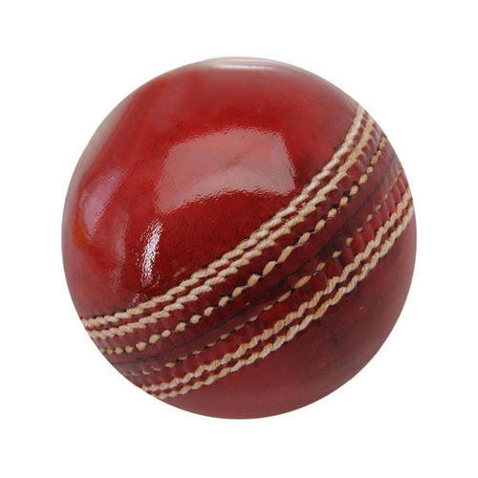
19

Slide 20
Fuzzy Sets
Fuzziness is used where it is not possible to make precise statements.
  X = (small, large)
  X = (?, 6.2, 7)
The objects belong to the set depending on a membership value which varies from 0 to 1.
  X = ([0,1], 6.2, 7)

Slide 21
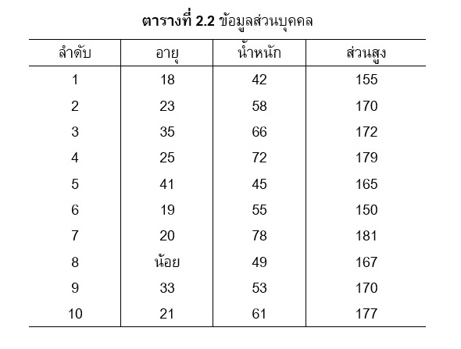

Slide 22
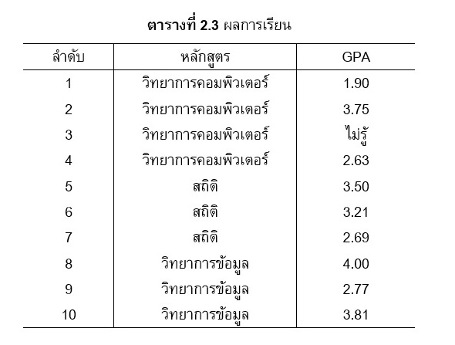

Slide 23
Distance Measure
Find the dissimilarity between pattern representations
Patterns which are more similar should be closer.

Slide 24
Distance Function
Metric
Non-Metric

Slide 25
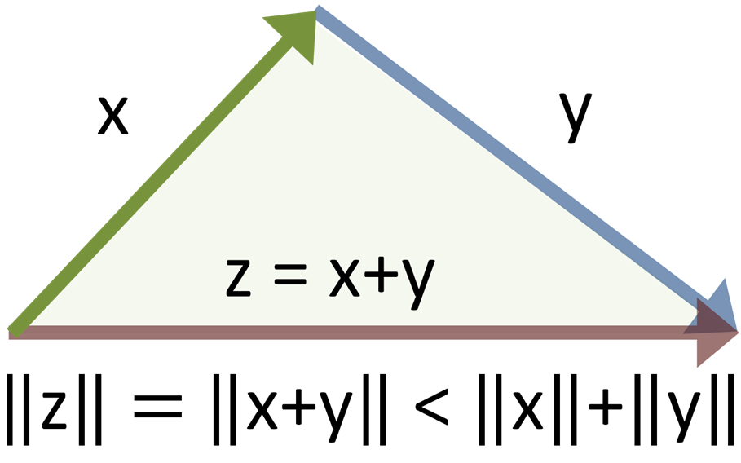
Metric
Positive Reflexivity: d(x, x) = 0
Symmetry: d(x, y) = d(y, x)
Triangular Inequality: d(x, y) ≤ d(x, z) + d(z, y)

Slide 26
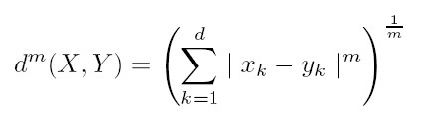
Minkowski Metric

Slide 27
Euclidean Distance (L₂; m = 2)
d²(x, y) = √ (x₁ – y₁)² + (x₂ – y₂)² + … + (x_{d} – y_{d})²

Slide 28
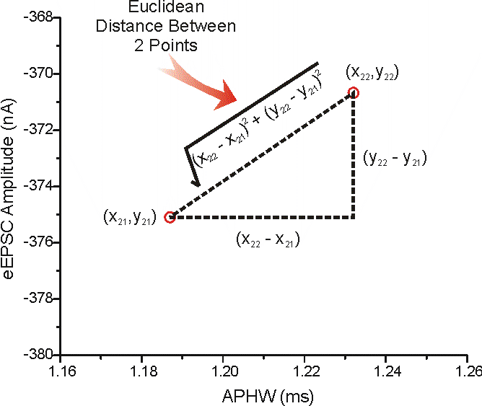

Slide 29
X = (4, 1, 3); Y = (2, 5, 1)
d(X, Y) = √ (4 – 2)² + (1 – 5)² + (3 – 1)² = 4.9

Slide 30
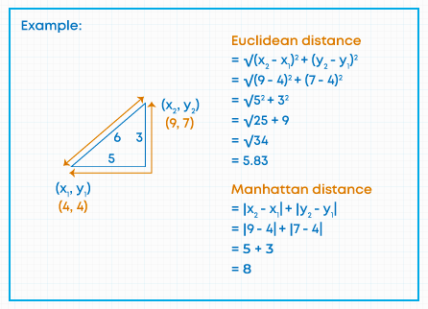

Slide 31
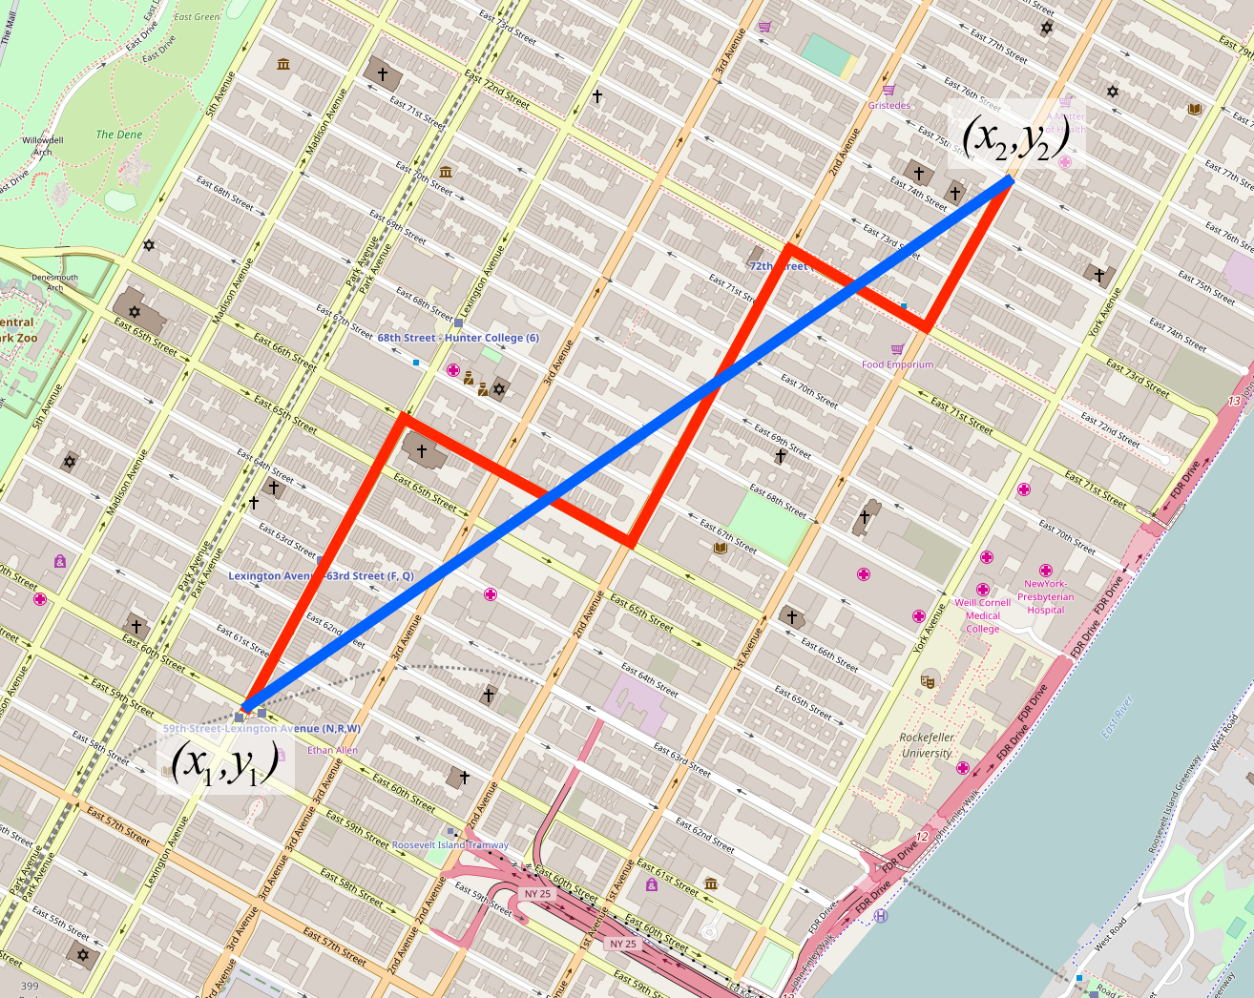

Slide 32
Distance Measure (cont.)
It should be ensure that all the features have the same range of values, failing which attributes with larger ranges will be treated as more important.
To ensure that all features are in the same range, normalisation of the feature values has to be carried out.

Slide 33
Example of Data
X₁ : (2, 120)
X₂ : (8, 533)
X₃ : (1, 987)
X₄ : (15, 1121)
X₅ : (18, 1023)

Slide 34
Example of Data (Cont.)
It gives the equal importance to every feature.
If the 2nd feature (much larger) is used for computing distances, the 1st feature will be insignificant and will not have any bearing on the classification.

Slide 35
Normalisation of Data
It divides every value of the feature by its maximum value.
All the values will lie between 0 and 1.

Slide 36
Normalisation of Data (cont.)
X₁ : (2, 120) X’₁ : (0.11, 0.11)
X₂ : (8, 533) X’₂ : (0.44, 0.48)
X₃ : (1, 987) X’₃ : (0.06, 0.88)
X₄ : (15, 1121) X’₄ : (0.83, 1.0)
X₅ : (18, 1023) X’₅ : (1.0, 0.91)
MAX : 18, 1121

Slide 37
Weighted Distance Measure
When attributes need to treated as more important, a weight can be added to their values.
w_{k} is the weight associated with
the k^{th} dimension (or feature).

Slide 38
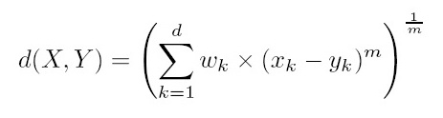
Weighted Distance Measure (cont.)

Slide 39
X = (4, 2, 3); Y = (2, 5, 1) w₁ = 0.3; w₂ = 0.6; w₃ = 0.1
d(X, Y) = √ 0.3×(4 – 2)² + 0.6 ×(1 – 5)² + 0.1 ×(3 – 1)²
= 3.35

Slide 40
Example of Data (Cont.)
X₁ : (2, 120)
X₂ : (8, 533)
X₃ : (1, 987)
X₄ : (15, 1121)
X₅ : (18, 1023)
w₁ = ? ; w₂ = ?

Slide 41
Non-Metric Similarity Functions
They do not obey either the triangular inequality or symmetry come under this category.
They are useful for images or string data.
They are robust to outliers or to extremely noisy data.

Slide 42
Non-Metric Similarity Functions (cont.)
k-Median Distance
Mutual Neighbourhood Distance

Slide 43
k-Median Distance
k-median operator returns the k^{th} value of the ordered difference vector.
X = (x₁, x₂, …, x_{n}) and Y = (y₁, y₂, …, y_{n})
d(X, Y) = k-median{sort(|x₁ – y₁|, …, |x_{n} – y_{n}|)}

Slide 44
X = (50, 3, 100, 29, 62, 140);
Y = (55, 15, 80, 50, 70, 170)
Difference Vector = {5, 12, 20, 21, 8, 30}
d(X, Y) = k-median {5, 8, 12, 20, 21, 30}
If k = 3, then d(X, Y) = 12

Slide 45
Mutual Neighbourhood Distance
For each data point
  All other data points are numbered from 1 to
  N – 1 in increasing order of some distance measure.
  The nearest neighbour is assigned value 1.
  Te farthest point is assigned the value N – 1.

Slide 46
Mutual Neighbourhood Distance (cont.)
MND(u, v) = NN(u, v) + NN(v, u)
  NN(u, v): The number of data point v w.r.t. u.
  NN(u, u) = 0
Symmetric
Reflexive
Not Triangular Inequality

Slide 47
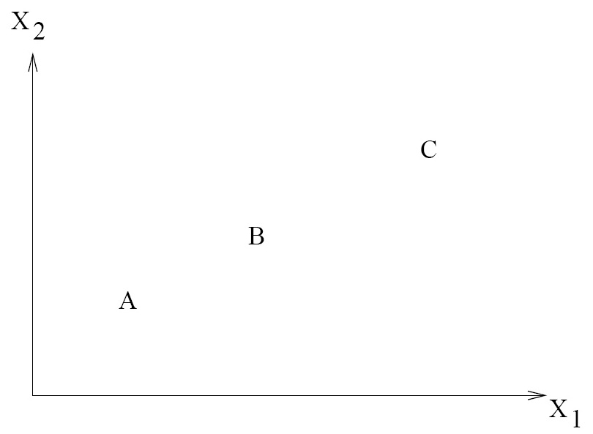
Ranking of A, B and C
MND(A, B) = 2
MND(B, C) = 3
MND(A, C) = 4
1 2
A B C
B A C
C B A

Slide 48
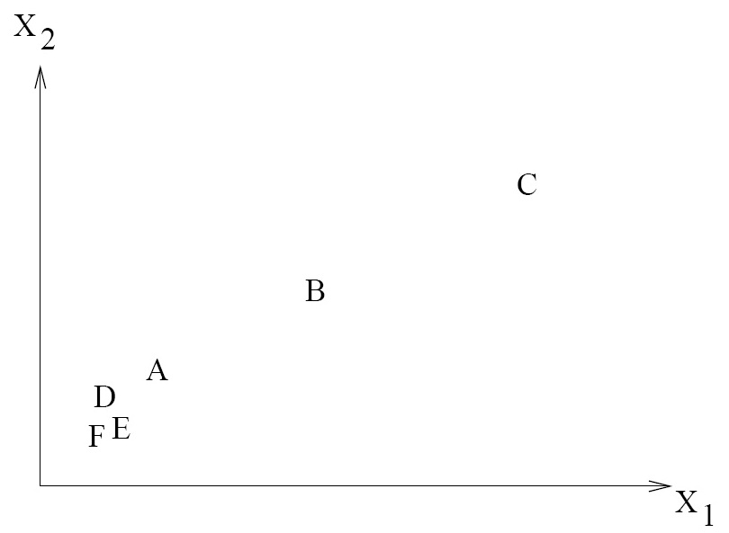
Ranking of A, B, C, D, E and F
MND(A, B) = 5
MND(B, C) = 3
MND(A, C) = 7
1 2 3 4 5
A D E F B C
B A C D E F
C B A D E F

Slide 49
Abstractions of the Data Set
A set of training patterns where the class label for each pattern is given, is used for classification.
The complete training set may not be used because the processing time may be too long but an abstraction of the training set can be used.

Slide 50
Abstractions of the Data Set (cont.)
No Abstraction of Patterns
Single Representative per Class
Multiple Representative per Class

Slide 51
No Abstraction of Patterns
All the training patterns are used.
k-Nearest Neighbour
  It uses the neighbours of the test pattern from all the training patterns.

Slide 52
Single representative per class
Centroid
  The sample mean of the points in the cluster
Medoid
  The most centrally located point in the cluster

Slide 53
Multiple representative per class
Cluster Representative
  Cluster Centres

Slide 54
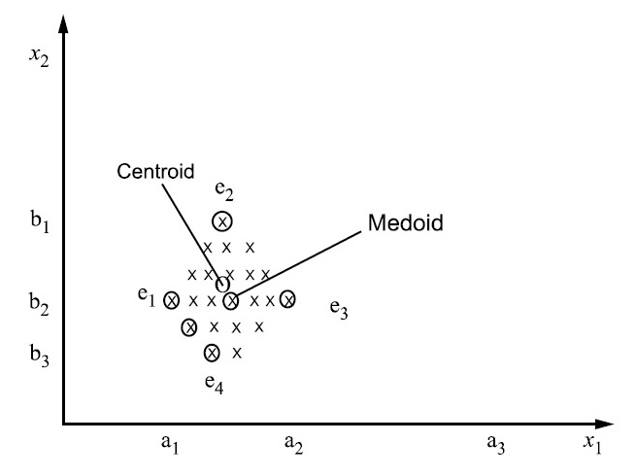
A Set of Data Points

Slide 55
Evaluation of Classifiers
Accuracy of the Classifier
Design Time and Classification Time
Space Required
Explanation Ability
Noise Tolerance

Slide 56
Accuracy of the Classifier
The main aim of using a classifier is to correctly classify unknown patterns.
The accuracy of the classifier is the parameter usually taken into account.

Slide 57
Design Time and Classification Time
Design Time
  Time to build the classifier from the training data
Classification Time
  Time to classify a pattern using the design classifier
  If the classification time is too large and it is required to carry out the classification task quickly, it may be better to sometimes sacrifice the accuracy and use a classifier which is faster.

Slide 58
Space Required
Abstraction: Less
No Abstraction: High
Hand-Held Devices
  It is good to use a classifier requiring little space.

Slide 59
Explanation Ability
The reason for the classifier in choosing the class of a pattern is clear to the user.
Medical Diagnostics
  Explanation ability may be necessary in a classifier so that the doctors are sure that the classifier is doing the right thing.

Slide 60
Noise Tolerance
The ability of the classifier to take care of outliers and patterns wrongly classified

Slide 61
Training and Test Sets
A training set is recognized to construct a classifier.
A test set is used to validate a classifier.

Slide 62
Experiment
Re-Substitution Estimate
Holdout Method
K-Fold Cross-Validation

Slide 63
Re-Substitution Estimate
An estimate can be made using the training set itself.
It assumes that the training data is a good representative of the data.

Slide 64
Holdout Method
The training set is divided into two sub-sets.
  Two-thirds of the data is used for training.
  One-thirds of the data is used for validation.
It could also be one-half for training and
one-half for testing or any other proportion.

Slide 65
K-Fold Cross-Validation
The data is divided into k equal sub-sets.
During each run
  One sub-set is used for testing.
  The rest of the sub-sets are used for training.
This procedure is carried out k times so that each sub-set is used for testing once.

Slide 66
Reference
Murty, M. N., Devi, V. S.: Pattern Recognition: An Algorithmic Approach (Undergraduate Topics in Computer Science). Springer (2012)

